Slide 1
AI Problem Solving
Siphokazi Tswane

Slide 2

Search and problem solving
Search in practice: getting from A to B
You’re in a foreign city, at some location (e.g. a hotel) and you need to get to another location.
What do you do?
Notes:
Imagine you’re in a foreign city, at some address (say a hotel) and want to use public transport to get to another address (a nice restaurant, perhaps). What do you do? If you are like many people, you pull out your smartphone, type in the destination and start following the instructions.

Slide 3
Search and problem solving (Cont.)
This question belongs to the class of search and planning problems.
Similar problems need to be solved by self-driving cars, and (perhaps less obviously) AI for playing games.
In the game of chess, for example, the difficulty is not so much in getting a piece from A to B as keeping your pieces safe from the opponent.
Notes:
This question belongs to the class of search and planning problems.
Similar problems need to be solved by self-driving cars, and (perhaps less obviously) AI for playing games.
In the game of chess, for example, the difficulty is not so much in getting a piece from A to B as keeping your pieces safe from the opponent.

Slide 4
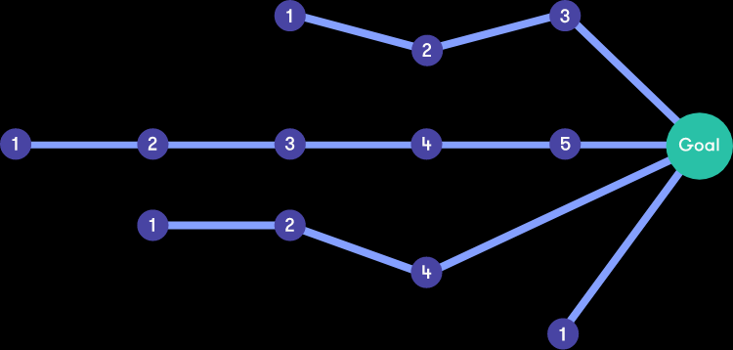
Search and problem solving (Cont.)
There are many different ways to solve the problem,
some of which may be more preferable in terms of time, effort, cost or other criteria.
Different search techniques may lead to different solutions.
Notes:
Often there are many different ways to solve the problem, some of which may be more preferable in terms of time, effort, cost or other criteria. Different search techniques may lead to different solutions, and developing advanced search algorithms is an established research area.

Slide 5
intro
This chapter describes one kind of goal-based agent called a problem-solving agent.
Problem-solving agents use atomic representations states of the world are considered as wholes, with no internal structure visible to the problem solving algorithms.
The discussion of problem solving begins with precise definitions of problems and their solutions and give several examples to illustrate these definitions.
We then describe several general-purpose search algorithms that can be used to solve these problems.
We will see several uninformed search algorithms—algorithms that are given no information about the problem other than its definition.
Notes:
This chapter describes one kind of goal-based agent called a problem-solving agent. You will remember from the previous chapter that An agent is anything that can be viewed as perceiving its environment through sensors and acting upon that environment through actuators.
Problem-solving agents use atomic representations states of the world that are considered as wholes, with no internal structure visible to the problem solving algorithms.
An algorithm is a process or set of rules to be followed in calculations or other problem-solving operations, especially by a computer. / An algorithm is a specific procedure for solving a well-defined computational problem. The development and analysis of algorithms is fundamental to all aspects of computer science: artificial intelligence, databases, graphics, networking, operating systems, security, and so on.
Goal-based agents that use more advanced factored or structured representations are usually called planning agents.
The discussion of problem solving begins with precise definitions of problems and their solutions and give several examples to illustrate these definitions. We then describe several general-purpose search algorithms that can be used to solve these problems. We will see several uninformed search algorithms—algorithms that are given no information about the problem other than its definition.

Slide 6
PROBLEM-SOLVING AGENTS
Intelligent agents are supposed to maximize their performance measure.
achieving this is sometimes simplified if the agent can adopt a goal and aim at satisfying it.
The decision problem is a complex one involving many tradeoffs and careful analysis
Agent adopts a goal - Goals help organize behaviour by limiting the objectives that the agent is trying to achieve and hence the actions it needs to consider.
Goal formulation based on the current situation and the agent’s performance measure, is the first step in problem solving
Limiting objectives current state
Notes:
Imagine an agent in the city of Arad, Romania, enjoying a touring holiday. (Or perhaps another city in a different country lets Rome in Italy.) The agent’s performance measure contains many factors: it wants to improve its suntan, improve its local language skills such as Romanian in Romania (or Italian in Italy), take in the sights, enjoy the nightlife (such as it is), avoid hangovers, and so on. The decision problem is a complex one involving many tradeoffs and careful reading of guidebooks.
Now, suppose the agent has a nonrefundable ticket to fly out of Bucharest the following day. In that case, it makes sense for the agent to adopt the goal of getting to Bucharest. Courses of action that don’t reach Bucharest on time can be rejected without further consideration and the agent’s decision problem is greatly simplified.
Goals help organize behavior by limiting the objectives that the agent is trying to achieve and hence the actions it needs
to consider.
Goal formulation, based on the current situation and the agent’s performance measure, is the first step in problem solving.

Slide 7
We will consider a goal to be a set of world states—exactly those states in which the goal is satisfied.
The agent’s task is to find out how to act, now and in the future, so that it reaches a goal state. Before it can do this, it needs to decide (or we need to decide on its behalf) what sorts of actions and states it should consider.
If it were to consider actions at the lowest level the agent would probably never reach the goal state, because at that level of detail there is too much uncertainty in the world and there would be too many steps in a solution.
Problem formulation is the process of deciding what actions and states to consider, given a goal.
Notes:
We will consider a goal to be a set of world states—exactly those states in which the
goal is satisfied. The agent’s task is to find out how to act, now and in the future, so that it
reaches a goal state. Before it can do this, it needs to decide (or we need to decide on its
behalf) what sorts of actions and states it should consider. If it were to consider actions at
the level of “move the left foot forward an inch” or “turn the steering wheel one degree left,”
the agent would probably never find its way out of the parking lot, let alone to Bucharest,
because at that level of detail there is too much uncertainty in the world and there would be
too many steps in a solution. Problem formulation is the process of deciding what actions
and states to consider, given a goal. We discuss this process in more detail later. For now, let
us assume that the agent will consider actions at the level of driving from one major town to
another. Each state therefore corresponds to being in a particular town.

Slide 8
The Agent needs information regarding the environment e.g. Known, unknown, deterministic, observable etc.
Under these assumptions, the solution to any problem is a fixed sequence of actions.
If the agent knows the initial state and the environment is known and deterministic, it knows exactly where it will be after the first action and what it will perceive. Since only one percept is possible after the first action, the solution can specify only one possible second action, and so on.
SEARCH - The process of looking for a sequence of actions that reaches the goal is called search.
SOLUTION - A search algorithm takes a problem as input and returns a solution in the form of an action sequence.
EXECUTION - Once a solution is found, the actions it recommends can be carried out. This is called the execution phase.
Notes:
Properties of Environment
The environment has multifold properties −
Observable / Partially Observable − If it is possible to determine the complete state of the environment at each time point from the percepts it is observable; otherwise it is only partially observable.
Accessible / Inaccessible − If the agent’s sensory apparatus can have access to the complete state of the environment, then the environment is accessible to that agent.
Deterministic / Non-deterministic − If the next state of the environment is completely determined by the current state and the actions of the agent, then the environment is deterministic; otherwise it is non-deterministic.
Well, in general it could be a branching strategy that recommends different actions in the future depending on what percepts arrive.
For example, under less than ideal conditions, the agent might plan to drive from Arad to
Sibiu and then to Rimnicu Vilcea but may also need to have a contingency plan in case it
arrives by accident in Zerind instead of Sibiu. Fortunately, if the agent knows the initial state
and the environment is known and deterministic, it knows exactly where it will be after the
first action and what it will perceive. Since only one percept is possible after the first action,
the solution can specify only one possible second action, and so on. The process of looking for a sequence of actions that reaches the goal is called search.
A search algorithm takes a problem as input and returns a solution in the form of an action
sequence. Once a solution is found, the actions it recommends can be carried out. This
is called the execution phase.

Slide 9
While the agent is executing the solution sequence it ignores its percepts when choosing an action because it knows in advance what they will be.
OPEN-LOOP SYSTEM - An agent that carries out its plans with its eyes closed, so to speak, must be quite certain of what is going on.
It ignores the percepts breaks the loop between agent and environment.
Notes:
We use the term percept to refer to the agent’s perceptual inputs at any given instant. An agent’s percept sequence is the complete history of everything the agent has ever perceived. In general, an agent’s choice of action at any given instant can depend on the entire percept sequence observed to date, but not on anything it hasn’t perceived. By specifying the agent’s choice of action for every possible percept sequence, we have said more or less everything there is to say about the agent.

Slide 10
Functionality of a problem
Goal Formulation
Problem Formulation
Search
Execution
Solution
Limiting the objectives of the Current State
Once a solution is found, the actions it recommends are carried out
Search Algorithms
Takes a problem as input and returns a solution
Looking for Sequence of Actions
Actions and States
Notes:
Summary – see current slide
Goal Formulation: It is the first and simplest step in problem-solving. It organizes the steps/sequence required to formulate one goal out of multiple goals as well as actions to achieve that goal. Goal formulation is based on the current situation and the agent’s performance measure (discussed below).
Problem Formulation: It is the most important step of problem-solving which decides what actions should be taken to achieve the formulated goal. There are following five components involved in problem formulation:
1. Initial State: It is the starting state or initial step of the agent towards its goal.
2. Actions: It is the description of the possible actions available to the agent.
3. Transition Model: It describes what each action does.
4. Goal Test: It determines if the given state is a goal state.
5. Path cost: It assigns a numeric cost to each path that follows the goal. The problem-solving agent selects a cost function, which reflects its performance measure. Remember, an optimal solution has the lowest path cost among all the solutions.
Search: It identifies all the best possible sequence of actions to reach the goal state from the current state. It takes a problem as an input and returns solution as its output.
Solution: It finds the best algorithm out of various algorithms, which may be proven as the best optimal solution.
Execution: It executes the best optimal solution from the searching algorithms to reach the goal state from the current state.

Slide 11
Well-defined problems and solutions
A problem can be defined formally by five components:-
The initial state that the agent starts in. e.g. the initial state for our agent in Romania might be described as In(Arad).
A description of the possible actions available to the agent. Given a particular state s, returns the set of actions that can be executed in s. We say that each of these actions is applicable in s. e.g. from the state In(Arad), the applicable actions are {Go(Sibiu), Go(Timisoara), Go(Zerind)}.
A description of what each action does; called the transition model, specified by a function RESULT(s, a) that returns the state that results from doing action a in state s.
The term successor to refer to any state reachable from a given state by a single action
E.g. RESULT(In(Arad),Go(Zerind)) = In(Zerind) .
Notes:
Problem Formulation
A problem consists of five parts: the initial state, a set of actions, a transition model describing the results of those actions, a goal test function, and a path cost function.
The environment of the problem is represented by a state space. A path through the state space from the initial state to a goal state is a solution.
Components to formulate the associated problem:
Initial State: This state requires an initial state for the problem which starts the AI agent towards a specified goal. In this state new methods also initialize problem domain solving by a specific class.
Action: This stage of problem formulation works with function with a specific class taken from the initial state and all possible actions done in this stage.
Transition or transition model: This stage of problem formulation integrates the actual action done by the previous action stage and collects the final stage to forward it to their next stage.
Goal test: This stage determines that the specified goal achieved by the integrated transition model or not, whenever the goal achieves stop the action and forward into the next stage to determines the cost to achieve the goal.
Path costing: This component of problem-solving numerical assigned what will be the cost to achieve the goal. It requires all hardware software and human working cost. Remember, an optimal solution has the lowest path cost among all the solutions.
Note: Initial state, actions, and transition model together define the state-space of the problem implicitly. State-space of a problem is a set of all states which can be reached from the initial state followed by any sequence of actions. The state-space forms a directed map or graph where nodes are the states, links between the nodes are actions, and the path is a sequence of states connected by the sequence of actions.

Slide 13
Together, the initial state, actions, and transition model implicitly define the state space of the problem—the set of all states reachable from the initial state by any sequence of actions.
The state space forms a directed network or graph in which the nodes are states and the links between nodes are actions.
A path in the state space is a sequence of states connected by a sequence of actions.
The goal test, which determines whether a given state is a goal state. Sometimes theres an explicit set of possible goal states, and the test simply checks whether the given state is one of them.
Sometimes the goal is specified by an abstract property rather than an explicitly enumerated set of states. For example, in chess, the goal is to reach a state called “checkmate,” where the opponent’s king is under attack and can’t escape
Notes:
Goal test: This stage determines that the specified goal achieved by the integrated transition model or not, whenever the goal achieves stop the action and forward into the next stage to determines the cost to achieve the goal.
Path costing: This component of problem-solving numerical assigned what will be the cost to achieve the goal. It requires all hardware software and human working cost. Remember, an optimal solution has the lowest path cost among all the solutions.
A path through the state space from the initial state to a goal state is a solution.

Slide 14
Notes:
The step cost of taking action a in state s to reach state s is denoted by c(s, a, s). The step costs for Romania are shown in Figure 3.2 as route distances. We assume that step costs are nonnegative.

Slide 15
A path cost function that assigns a numeric cost to each path. The problem-solving agent chooses a cost function that reflects its own performance measure.
For the agent trying to get to Bucharest, time is of the essence, so the cost of a path might be its length in kilometers. In this chapter, we assume that the cost of a path can be described as the sum of the costs of the individual actions along the path.
The step cost of taking action a in state s to reach state s is denoted by c(s, a, s). The step costs for Romania are shown in Figure 3.2 as route distances. We assume that step costs are nonnegative.
The preceding elements define a problem and can be gathered into a single data structure that is given as input to a problem-solving algorithm.
A solution to a problem is an action sequence that leads from the initial state to a goal state. Solution quality is measured by the path cost function, and an optimal solution has the lowest path cost among all solutions.
Notes:
A problem consists of five parts: the initial state, a set of actions, a transition model
describing the results of those actions, a goal test function, and a path cost function.
The environment of the problem is represented by a state space. A path through the
state space from the initial state to a goal state is a solution.
Goal test: This stage determines that the specified goal achieved by the integrated transition model or not, whenever the goal achieves stop the action and forward into the next stage to determines the cost to achieve the goal.
Path costing: This component of problem-solving numerical assigned what will be the cost to achieve the goal. It requires all hardware software and human working cost. Remember, an optimal solution has the lowest path cost among all the solutions.

Slide 16
Formulating problems
In the preceding section we proposed a formulation of the problem of getting to Bucharest in terms of the initial state, actions, transition model, goal test, and path cost. This formulation seems reasonable, but it is still a model—an abstract mathematical description—and not the real thing.
Compare the simple state description we have chosen, In(Arad), to an actual cross country trip, where the state of the world includes so many things: the traveling companions, the current radio program, the scenery out of the window, the proximity of law enforcement officers, the distance to the next rest stop, the condition of the road, the weather, and so on.
All these considerations are left out of our state descriptions because they are irrelevant to the problem of finding a route to Bucharest.
The process of removing detail from a representation is called abstraction.
In addition to abstracting the state description, we must abstract the actions themselves. A driving action has many effects.
Notes:
In the preceding section we proposed a formulation of the problem of getting to Bucharest in terms of the initial state, actions, transition model, goal test, and path cost. This formulation seems reasonable, but it is still a model—an abstract mathematical description—and not the real thing.
Compare the simple state description we have chosen, In(Arad), to an actual cross country trip, where the state of the world includes so many things: the traveling companions, the current radio program, the scenery out of the window, the proximity of law enforcement officers, the distance to the next rest stop, the condition of the road, the weather, and so on.
All these considerations are left out of our state descriptions because they are irrelevant to the problem of finding a route to Bucharest.
The process of removing detail from a representation is called abstraction.
In addition to abstracting the state description, we must abstract the actions themselves. A driving action has many effects.

Slide 17
EXAMPLE PROBLEMS
The problem-solving approach has been applied to a vast array of task environments.
We list some of the best known here, distinguishing between toy and real-world problems.
A toy problem is intended to illustrate or exercise various problem-solving methods.
It can be given a concise, exact description and hence is usable by different researchers to compare the performance of algorithms.
A real-world problem is one whose solutions people actually care about.
Such problems tend not to have a single agreed-upon description, but we can give the general flavor of their formulations.
Notes:
Basically, there are two types of problem approaches:
Toy Problem: It is a concise and exact description of the problem which is used by the researchers to compare the performance of algorithms.
Real-world Problem: It is real-world based problems which require solutions. Unlike a toy problem, it does not depend on descriptions, but we can have a general formulation of the problem.

Slide 18
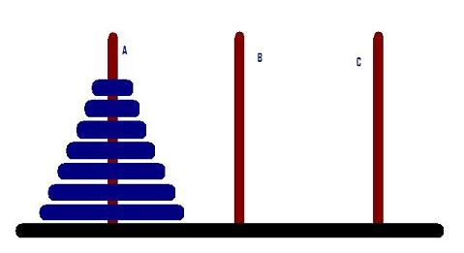
TOWER OF HANOI
How do move transfer the discs in A to B such that the larger disk is always at the base of a smaller one?

Slide 19
Missionary and Cannibal Problem:
There are 3 Missionaries and 3 Cannibals by the river side. The boat can only carry 2 persons at a time. If the number of Cannibals is more than that of Missionaries at any time in the Journey, the Cannibals will overpower the missionary and eat them.
How do you devise a transport protocol to have both Missionaries and Cannibals on the other side of the river?

Slide 20
Water Jug Problem:
You are given two jugs, a 4-gallon one and a 3-gallon one. Neither has any measuring made on it. There is a pump that can be used to fill the jugs with water. How can you get exactly 2 gallons of water into the 4- gallon jug?
Notes:
Water Jug Problem:
We are given two jugs, a 4-gallon one and 3-gallon one. Neither has any measuring marked on it. There is a pump, which can be used to fill the jugs with water. How can we get exactly 2 gallons of water into 4-gallon jug?

Slide 21
State Spaces for Water Jug Problem
• A state: (x, y)
x = 0, 1, 2, 3, or 4 y = 0, 1, 2, or 3.
• Start state: (0, 0).
• Goal state: (2, n) for any n, n = 0, 1, 2, 3.
• Attempting to end up in a goal state by using rules.
Notes:
The state space for this problem can be described as the set of ordered pairs of integers (X, Y) such that X = 0, 1, 2, 3 or 4 and Y = 0, 1, 2 or 3;
X is the number of gallons of water in the 4-gallon jug and Y the quantity of water in the 3-gallon jug.
The start state / initial state is (0, 0) and the goal state is (2, n) for any value of n, as the problem does not specify how many gallons need to be filled in the 3-gallon jug (0, 1, 2, 3). So the problem has one initial state and many goal states. Some problems may have many initial states and one or many goal states.
[The natural (or counting) numbers are 1,2,3,4,5,1,2,3,4,5, etc. There are infinitely many natural numbers. The set of natural numbers, {1,2,3,4,5,...}{1,2,3,4,5,...}, is sometimes written N or n for short]
https://www.youtube.com/watch?v=GUF-RbTVgGo
https://www.engineeringenotes.com/artificial-intelligence-2/state-space-search/notes-on-water-jug-problem-artificial-intelligence/34582

Slide 22
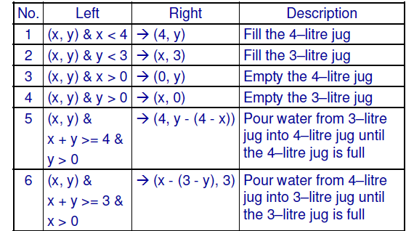
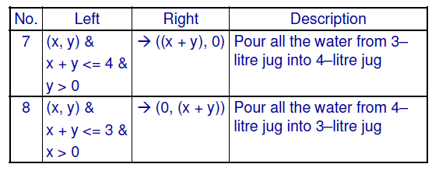
Notes:
Here is one solution that we can use. We must define a set of operators that will take us from one state to another. (The operators to be used to solve the problem can be described as shown in Fig above)

Slide 23
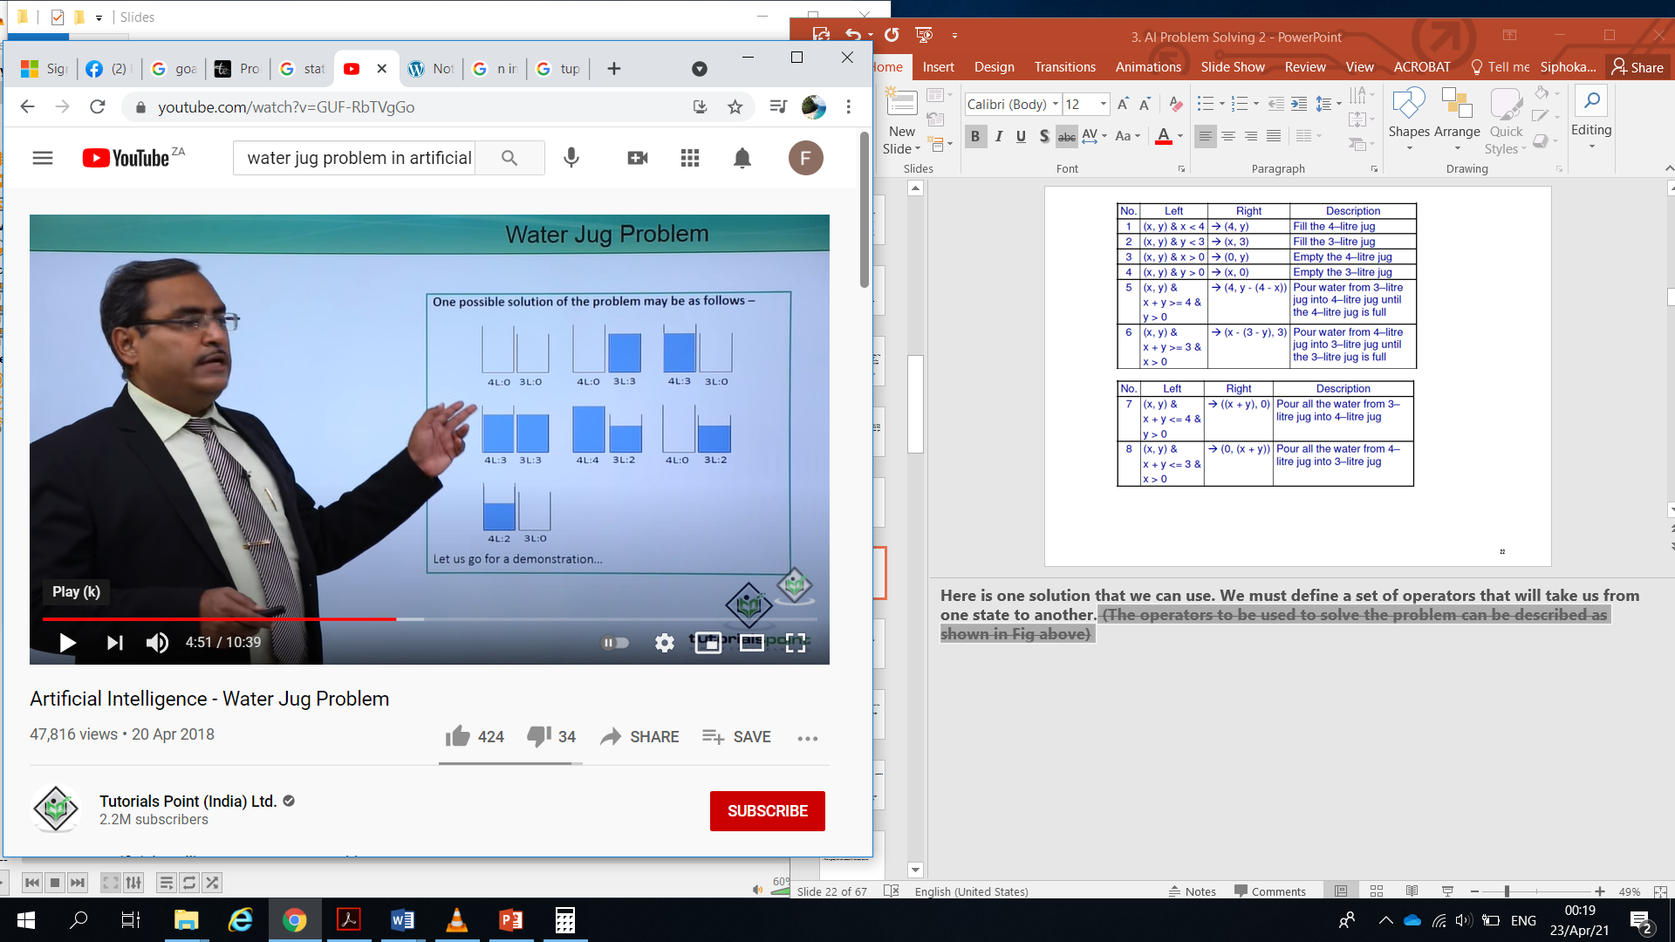
Transition Rules
1. current state = (0, 0)
2. Loop until reaching the goal state (2, 0)
– Apply a rule whose left side matches the current state
– Set the new current state to be the resulting state
(0 0) 2nd rule
(0 3) 7th rule
(3 0) 2nd rule
(3 3) 7th rule
(4 2) 3rd rule
(0 2) 7th rule
(2 0)

Slide 24
Water Jug Problem
– The role of the condition in the left side of a rule restrict the application of the rule more efficient
– Special-purpose rules to capture special-case knowledge that can be used at some stage in solving a problem
• (x, y) & x < 4 →(4, y)
• (x, y) & x > 0 →(0, y)

Slide 25
To provide a formal description of a problem:
– Define a state space that contains all the possible configurations of the relevant objects.
– Specify the initial states.
– Specify the goal states.
– Specify a set of rules:
• What are unstated assumptions?
• How general should the rules be?
• How much knowledge for solutions should be in the rules?
Solving a problem = search in the state space by using
the rules + control strategy
Notes:
To formalize a problem the following steps are needed:
(i) Define the problem precisely, giving the specification of what the initial situation (s) and the final situation (s) will be.
(ii) Analyze the problem because a few important features can have immense impact on the suitability of different techniques available for solving the problem.
(iii) Represent the knowledge completely, which is necessary to solve problem in a given domain.
(iv) Choose the best technique(s) and apply it (them) to the particular problem.
Depending upon the control strategy to be used the performance of problem solving procedure can be improved or degraded. It is thus clear that to create a program for solving a problem simply the formal description of the problem has to be generated using the knowledge about the given problem. This process is called operationalization.
Water jug problem is a simple illustration of solving a problem through state space search. But many difficult problems such as understanding of natural Language which need to be solved by the AI techniques, the water jug problem can act as a strong basis for such tedious problems. This was done in the case of ELIZA, an early AI program.
Summarizingly any problem can be solved by the following series of step:
1. Define a state space which contains all the possible configurations of the relevant objects and even some impossible ones.
2. Specify one or more states within that space which would describe possible situations from which the problem solving process may start. These states are called the initial states.
3. Specify one or more states which would be acceptable as solutions to the problem. These states are called goal states.
4. Specify a set of rules which describe the actions (operators) available and a control strategy to decide the order of application of these rules.
The problem can be solved by collecting all knowledge of the problem, (in the present case, water jug problem) with the help of production rules and using an appropriate control strategy; move through the problem space until a path from an initial state to goal state is found.
This is the process of search which is fundamental to the problem solving process. (This does not, however, mean that other more direct approaches cannot be exploited. Whenever possible, they can be included in the search by embedding them into the rules).
Since search provides the core of many intelligent processes, it is useful to structure AI program in a way which facilitates describing and performing the search process.

Slide 26
Requirements of a good search strategy:
– It causes motion.
• Otherwise, it will never lead to a solution.
– It is systematic.
• Otherwise, it may use more steps than necessary.
– It is efficient.
• Find a good, but not necessarily the best, answer.

Slide 27
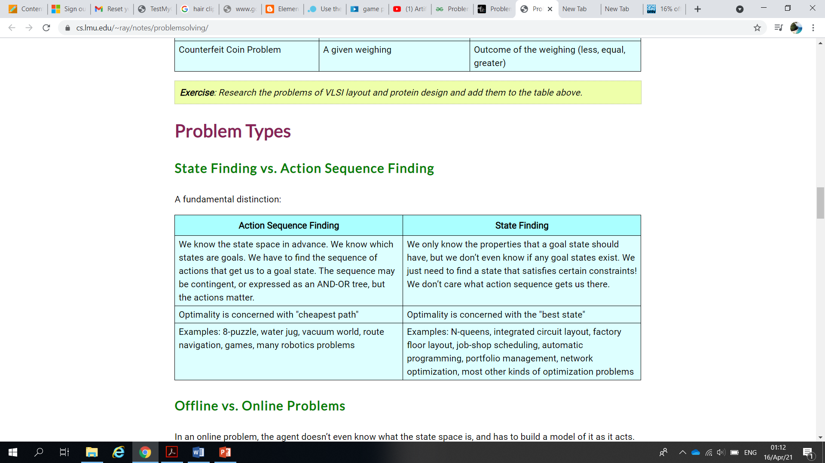
Problem Types
State Finding vs. Action Sequence Finding

Slide 28
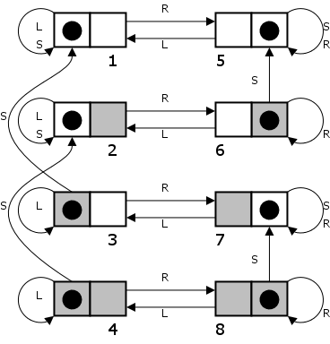
Offline vs. Online Problems
In an online problem, the agent doesn’t even know what the state space is, and has to build a model of it as it acts. In an offline problem, percepts don’t matter at all. An agent can figure out the entire action sequence before doing anything at all.
Offline Example: Vacuum World with two rooms, cleaning always works, a square once cleaned stays clean. States are 1 – 8, goal states are 1 and 5.

Slide 29
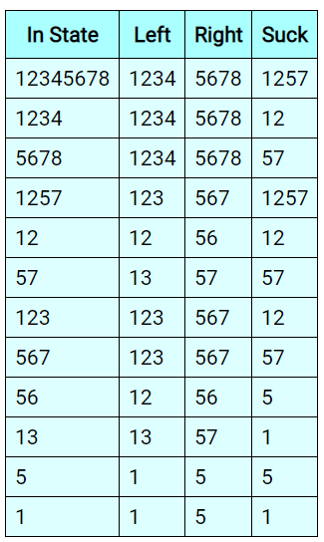
Sensorless (Conformant) Problems
The agent doesn’t know where it is. We can use belief states (sets of states that the agent might be in).
Example from above deterministic, static, single-agent vacuum world:
Note the goal states are 1 and 5. If a state 15 was reachable, it would be a goal too.

Slide 30
Contingency Problems
Contingency Problem: The agent doesn’t know what effect its actions will have. This could be due to the environment being partially observable, or because of another agent. Ways to handle this:
Solution is a list of conditional actions
Interleave search and execution
Example: Partially observable vacuum world (meaning you don’t know the status of the other square) in which sucking in a clean square may make it dirty.
No way to preplan a solution!!
A solution starting in a state where you’re in the left room and it’s dirty is:
Suck, Right, if dirty then Suck

Slide 31
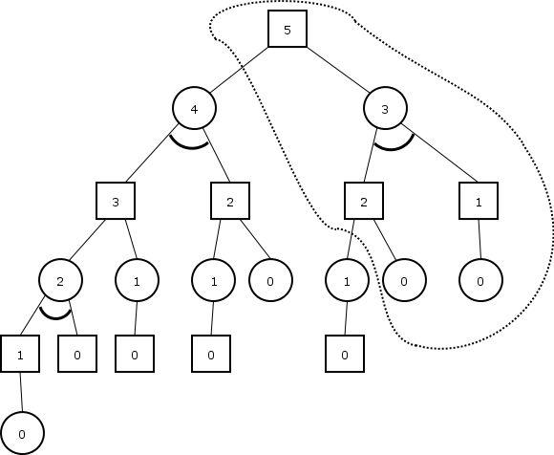
Can also model contingency problems is with "AND-OR graphs".
Example: find a winning strategy for Nim if there are only five stones in one row left. You are player square. You win if it is player circle’s turn with zero stones left.
In general then, a solution is a subtree in which
The root node is in the subtree
For every OR node in the subree, at least one child is in the subtree
For every AND node in the subtree, all children are in the subtree
All leaves are goal states
If the tree has only OR nodes, then the solution is just a path.

Slide 32
Search Algorithms

Slide 33
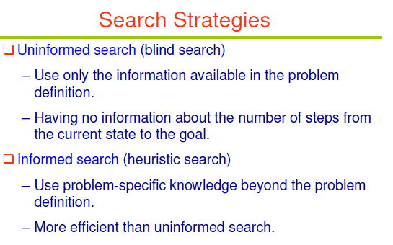
Notes:
Strategies that know whether one non-goal state is “more promising” than another are called informed search or heuristic search strategies.
Uninformed search (also called blind search) means that the strategies have no additional information about states beyond that provided in the problem definition. All they can do is
generate successors and distinguish a goal state from a non-goal state. All search strategies are distinguished by the order in which nodes are expanded.

Slide 34
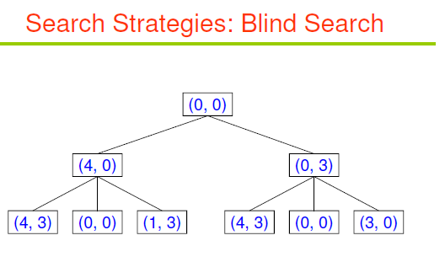
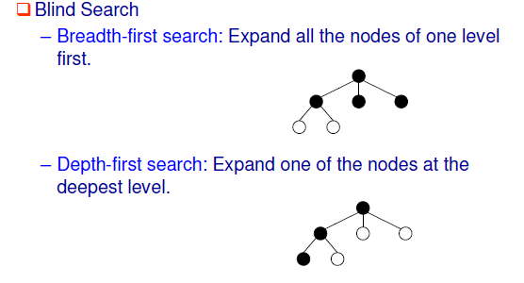
Notes:
Breadth-first search is a simple strategy in which the root node is expanded first, then all the successors of the root node are expanded next, then their successors, and so on. In general, all the nodes are expanded at a given depth in the search tree before any nodes at the next level are expanded.
Depth-first search always expands the deepest node in the current frontier of the search tree. The search proceeds immediately to the deepest level of the search tree, where the nodes have no successors. As those nodes are expanded, they are dropped from the frontier, so then the search “backs up” to the next deepest node that still has unexplored successors.

Slide 35
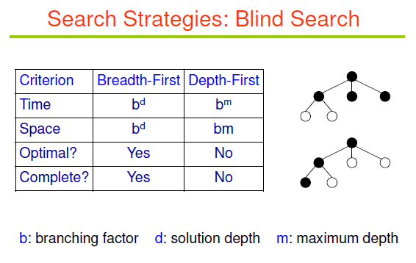

Slide 36
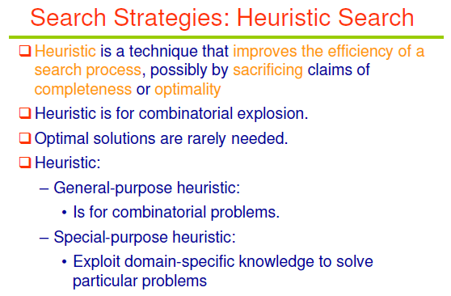
Notes:
This section shows how an informed search strategy—one that uses problem-specific knowledge
beyond the definition of the problem itself—can find solutions more efficiently than can
an uninformed strategy.
Heuristic functions are the most common form in which additional knowledge of the problem is imparted to the search algorithm.

Slide 37
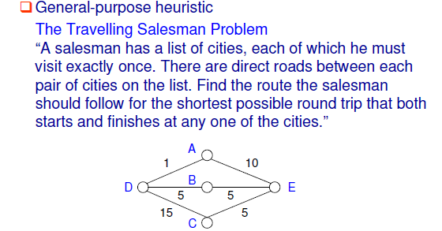
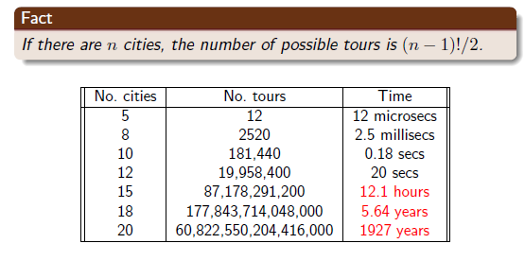

Slide 38
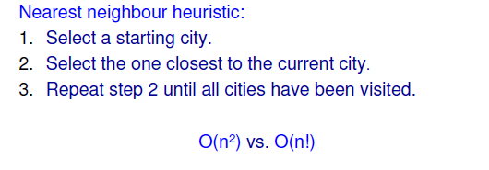
Heursitics for TSP
Branch and bound Technique:
Begin generating complete paths, keeping track of the shortest path found so far. Give up exploring any path as soon as its partial length becomes greater than the shortest path found so far.

Slide 39
Exercise
Assume you have the task to design a software agent that periodically allocates additional memory to as many nodes as possible on a computer network from a mutual resource pool. Discuss a suitable heuristic you would employ to realise an efficient resource allocation scheme for the network

Slide 40
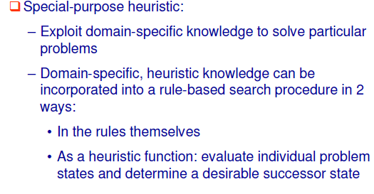
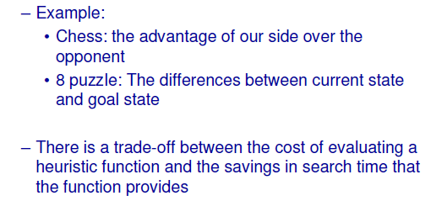

Slide 41
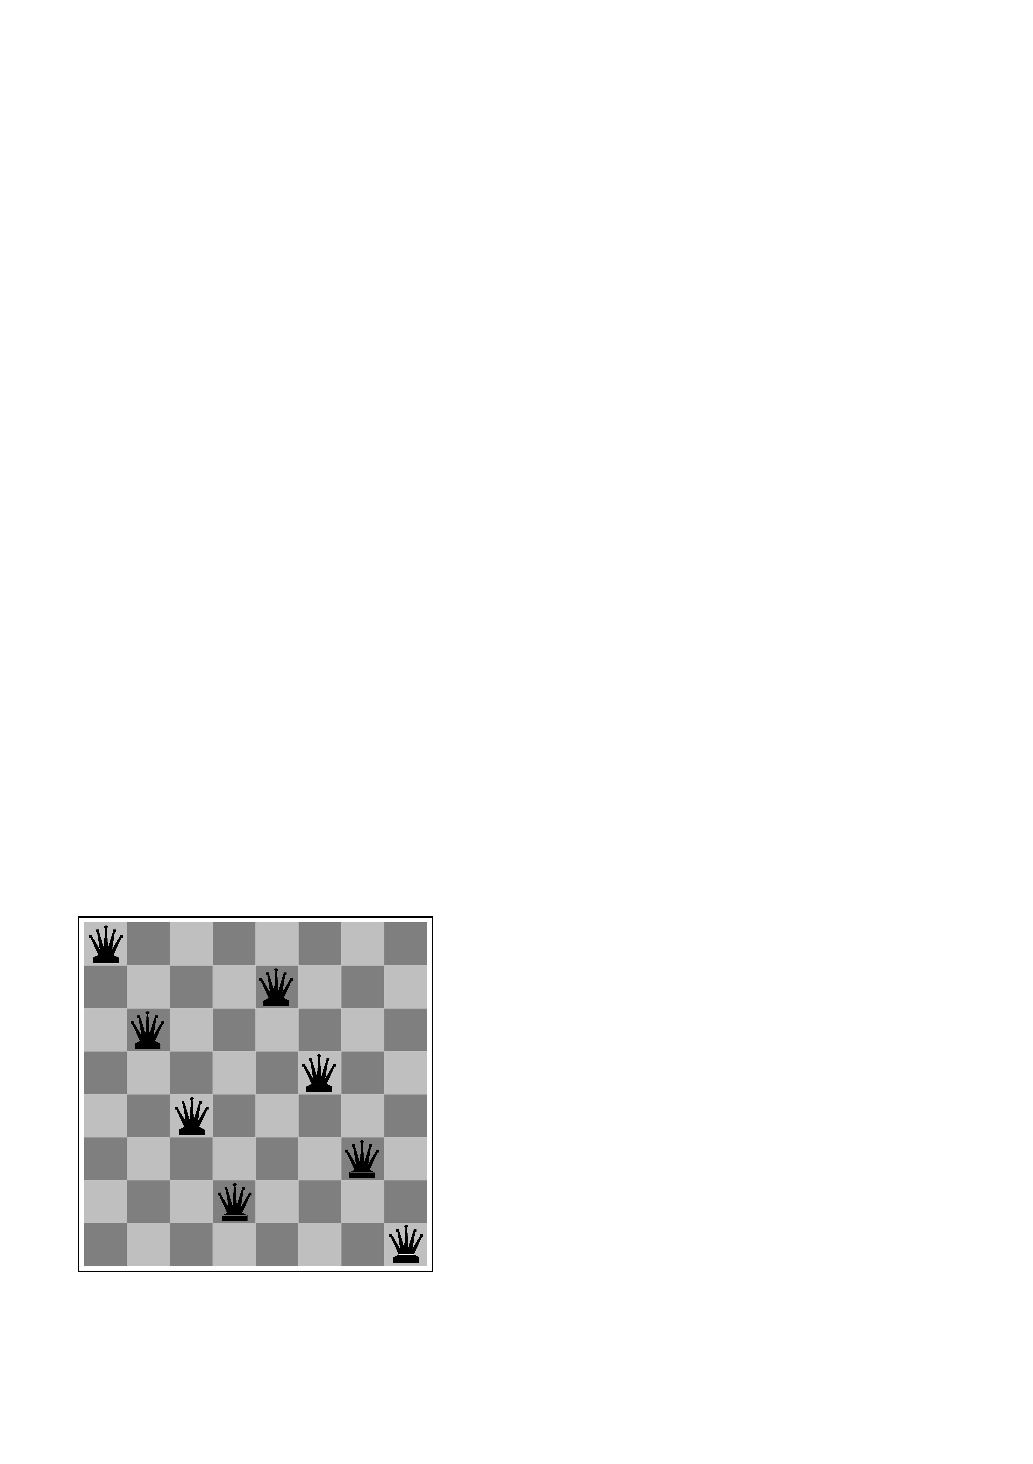
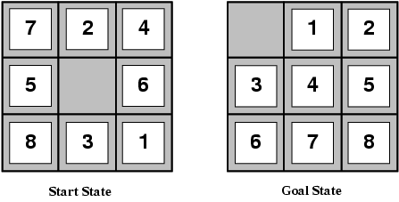
Example: 8-puzzle
Chess
SSP
states? -any arrangement of n<=8 queens
-or arrangements of n<=8 queens in leftmost n columns, 1 per column, such that no queen attacks any other.
initial state? no queens on the board
actions? -add queen to any empty square
-or add queen to leftmost empty square such that it is not attacked by other queens.
goal test? 8 queens on the board, none attacked.
path cost? 1 per move
State Space Problem (SSP) formulation
states? locations of tiles
initial state? Given
actions? move blank left, right, up, down
goal test? goal state (given)
path cost? 1 per move
Notes:
heuristics for the 8-puzzle, in order to shed light on the nature of heuristics in general.
The 8-puzzle was one of the earliest heuristic search problems. The object of the puzzle is to slide the tiles horizontally or vertically into the empty space until the configuration matches the goal configuration (SEE Figure above).
The average solution cost for a randomly generated 8-puzzle instance is about 22 steps. The branching factor is about 3. (When the empty tile is in the middle, four moves are possible; when it is in a corner, two; and when it is along an edge, three.) This means that an exhaustive tree search to depth 22 would look at about 322 ≈ 3.1×1010 states.
A graph search would cut this down by a factor of about 170,000 because only 9!/2 = 181, 440 distinct states are reachable. (See Exercise 3.4.) This is a manageable number, but the corresponding number for the 15-puzzle is roughly 1013, so the next order of business is to find a good heuristic function. If we want to find the shortest solutions by using A∗, we
need a heuristic function that never overestimates the number of steps to the goal. There is a
long history of such heuristics for the 15-puzzle; here are two commonly used candidates:
• h1 = the number of misplaced tiles. For Figure 3.28, all of the eight tiles are out of
position, so the start state would have h1 = 8. h1 is an admissible heuristic because it
is clear that any tile that is out of place must be moved at least once.
• h2 = the sum of the distances of the tiles from their goal positions.
Because tiles cannot move along diagonals, the distance we will count is the sum of the horizontal
and vertical distances. This is sometimes called the city block distance or Manhattan
distance.
h2 is also admissible MANHATTAN because all any move can do is move one tile one step
DISTANCE
closer to the goal. Tiles 1 to 8 in the start state give a Manhattan distance of
h2 = 3+1 + 2 + 2+ 2 + 3+ 3 + 2 = 18 .
As expected, neither of these overestimates the true solution cost, which is 26.

Slide 42
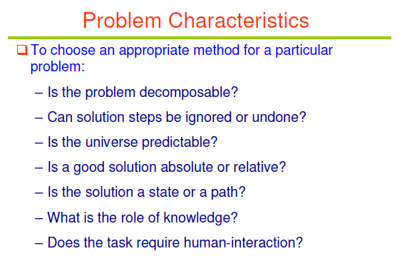

Slide 43
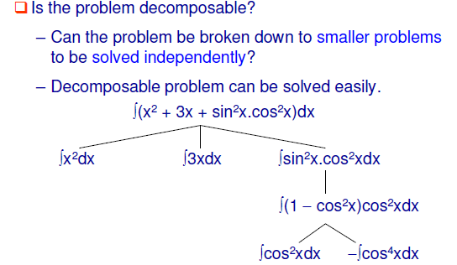
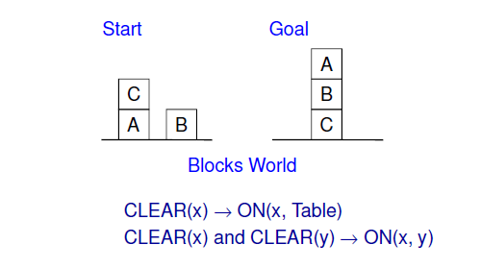

Slide 44
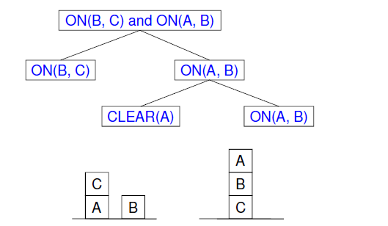
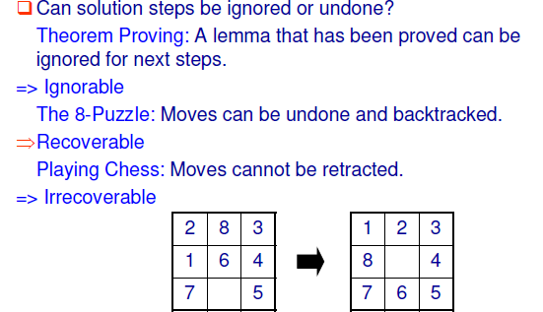

Slide 45
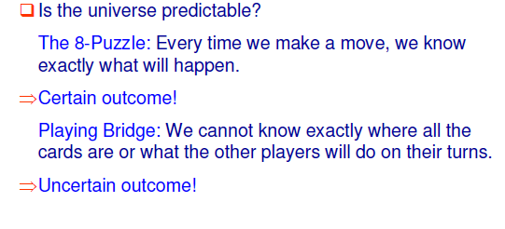
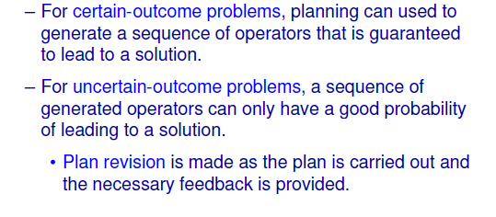

Slide 46
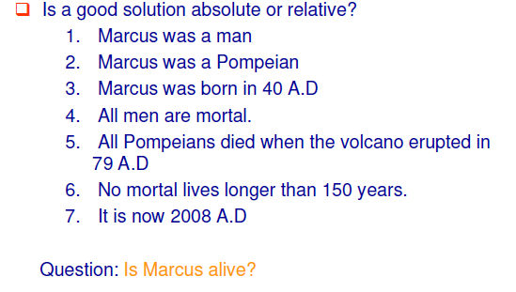
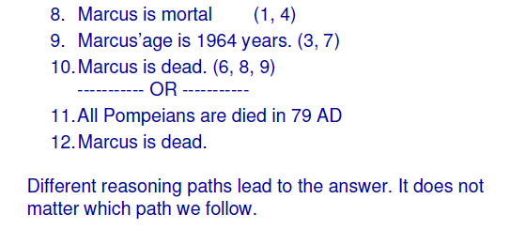

Slide 47
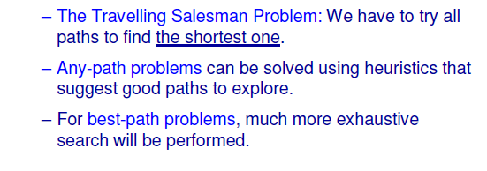
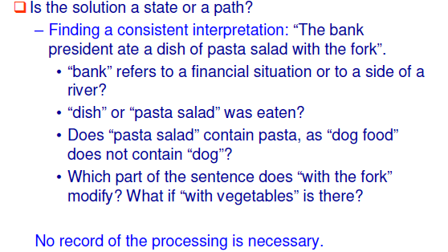

Slide 48
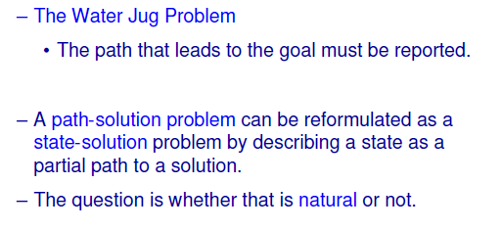
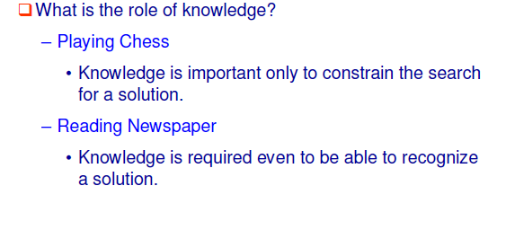

Slide 49
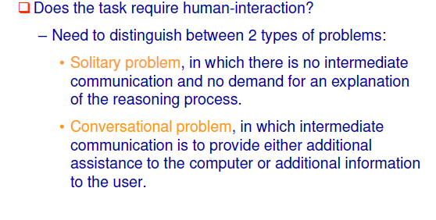
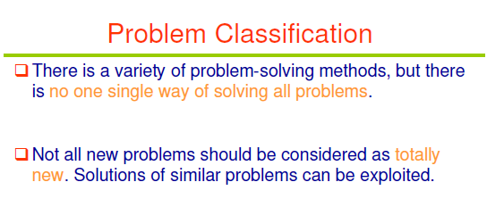

Slide 50
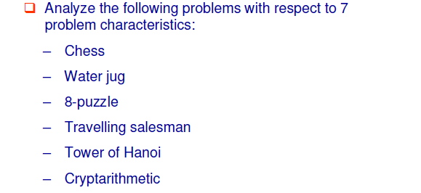
Tutorial Question

Slide 51
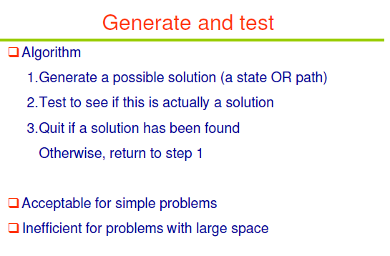

Slide 52
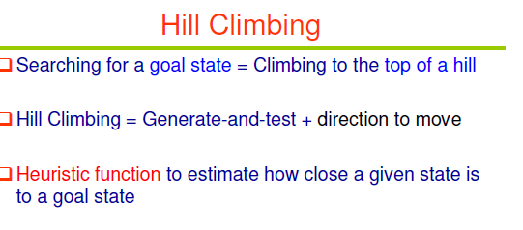

Slide 53
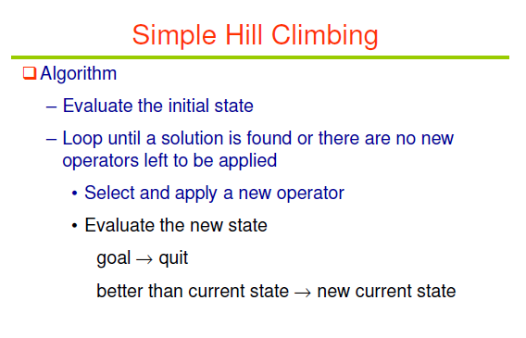
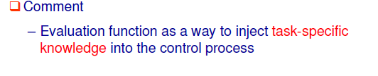

Slide 54
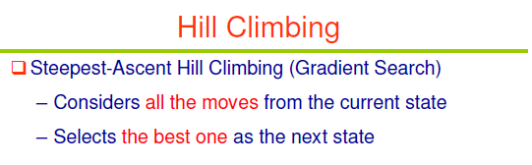
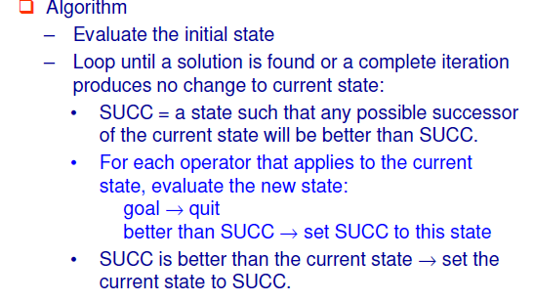

Slide 55
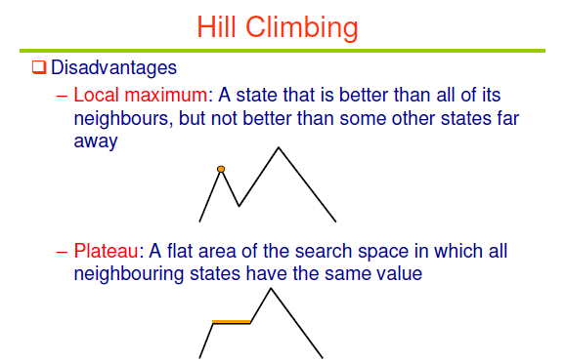
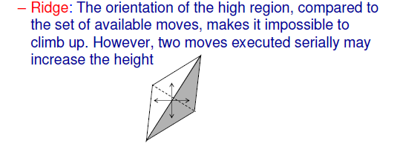

Slide 56
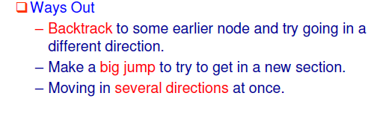
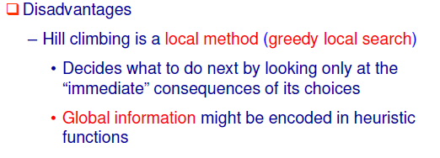
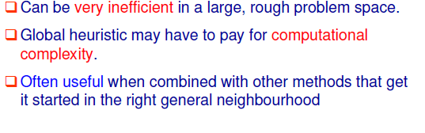

Slide 57
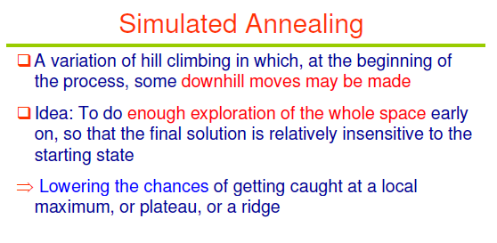
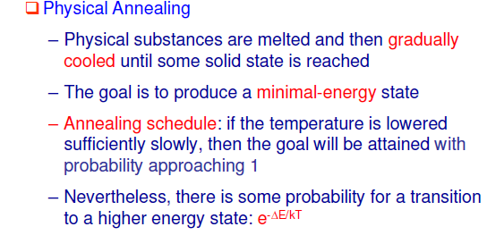

Slide 58


Slide 59


Slide 60


Slide 61


Slide 62


Slide 63



Slide 64


Slide 65


Slide 66



Slide 67



